Slide 1


PAYMENT TRANSFER
SanathKumar S J

Slide 2
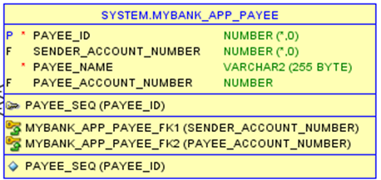
DESCRIPTION
Module enables the seamless transfer of funds between different accounts.
When account is established, if the user needs to do any transaction, they must have the payee data
Description: Users have the ability to access payee details by entering their account number.
Functionality: Retrieves payee information from the system's database based on the provided account number. If the account number is not there it will display appropriate message.

Slide 3
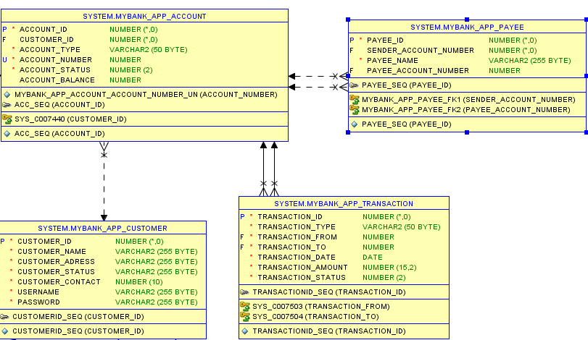
PAYMENT TRANSFER DATABASE DESIGN

Slide 4
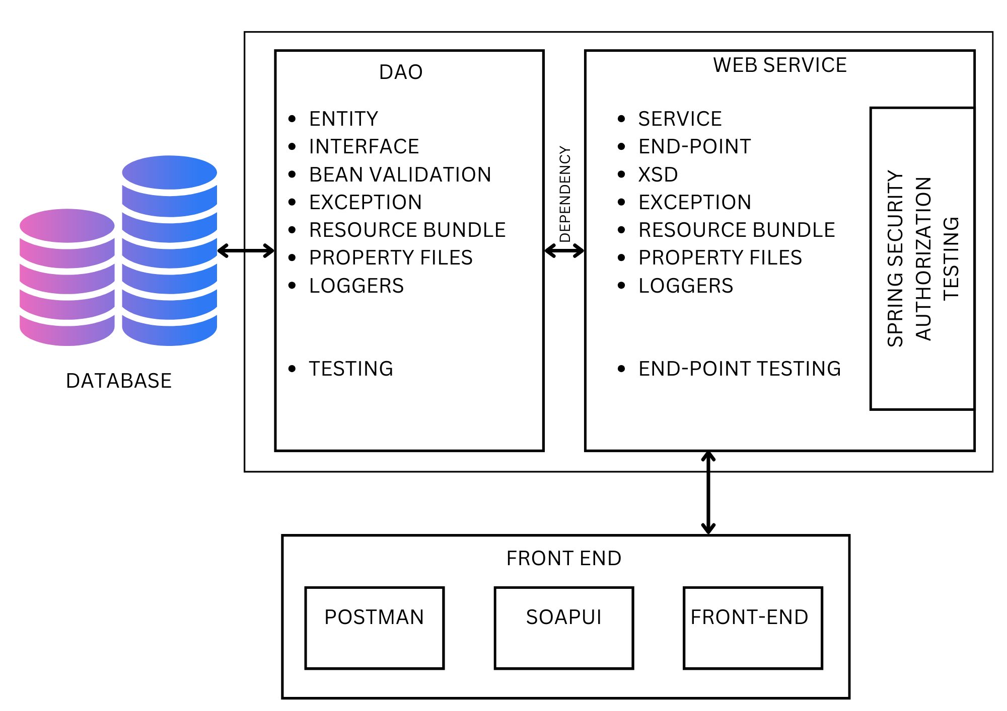
ARCHITECTURAL DIAGRAM

Slide 5

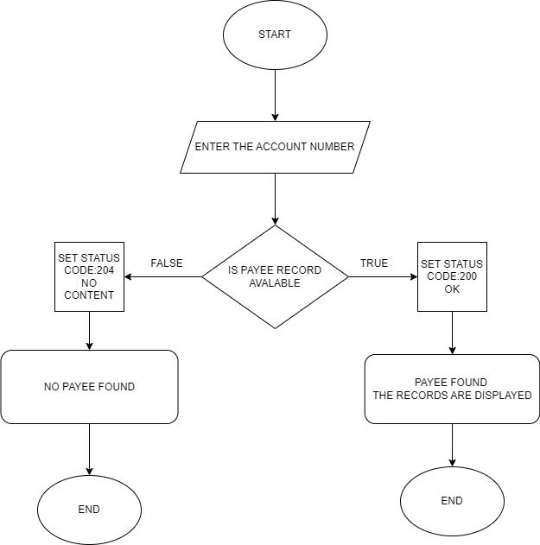



DATAFLOW DIAGRAM

Slide 6
FILES
JAR FILE (DAO LAYER) :
WAR FILE (WEB SERVICE) :
GIT HUB
DAO LAYER : DLTE-JAVA-FULL-STACK-SANATHKUMARSJ-2024/DLTE-PROJECT/PAYMENT_DAO at master · SanathKumarSJ/DLTE-JAVA-FULL-STACK-SANATHKUMARSJ-2024 (github.com)
WEB SERVICE : DLTE-JAVA-FULL-STACK-SANATHKUMARSJ-2024/DLTE-PROJECT/PAYMENT_WEBSERVICE at master · SanathKumarSJ/DLTE-JAVA-FULL-STACK-SANATHKUMARSJ-2024 (github.com)

Slide 7
Module 2: Adding New payee (REST)
Add new payee using rest controller and post mapping
Bean validation and exception handling
Validation at request body
PAYEE EXCEPTION
Invalid sender’s account number
Invalid payee’s account number
Invalid Payee name
GIT HUB
WEB SERVICE : DLTE-JAVA-FULL-STACK-SANATHKUMARSJ-2024/DLTE-PROJECT/PAYMENT_WEBSERVICE at master · SanathKumarSJ/DLTE-JAVA-FULL-STACK-SANATHKUMARSJ-2024 (github.com)

Slide 8
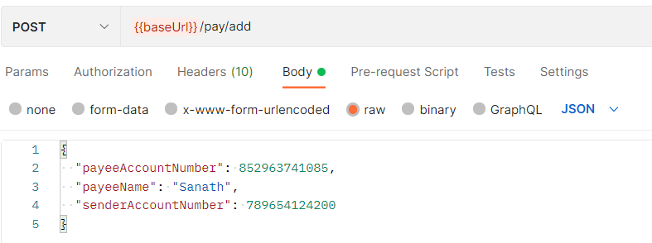
API-Documentation
Request Parameters: Any parameters that need to be included in the request (e.g., query parameters, path parameters, request body) and their formats.
This documentation serves as a guide for developers who want to interact with the API, providing information on how to use the API endpoints, the data formats it accepts and returns, authentication methods, error handling, and any other relevant details.

Slide 9
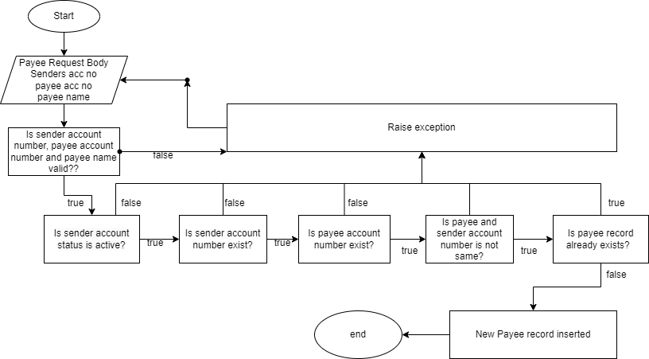
Flow Diagram

Slide 10
THANKYOU

